Slide 1
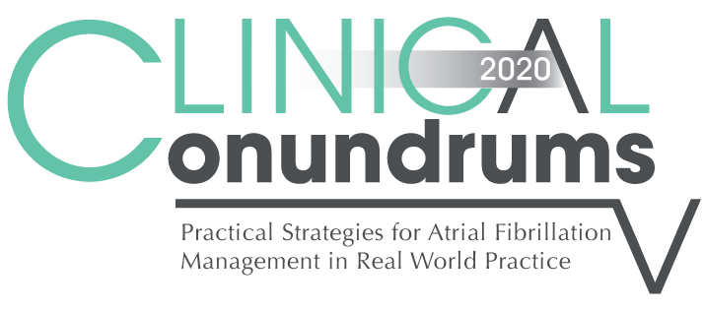



Case 4
CASE 5
Melvin
Real World Worsening Kidney Function

Slide 2

Learning Objectives
Upon completion of this activity, participants should be able to:
I
Explain the role of non-vitamin K antagonist oral anticoagulants (DOACs) in patients with chronic kidney disease (CKD)
II
Identify the clinical challenges presented by patients with worsening kidney function and transitioning from DOACs to warfarin
III
Describe the differences, advantages, and limitations among the formulae used for estimating kidney function; estimated Glomerular Filtration Rate (eGFR) and estimated Creatinine Clearance (CrCl)

Slide 3
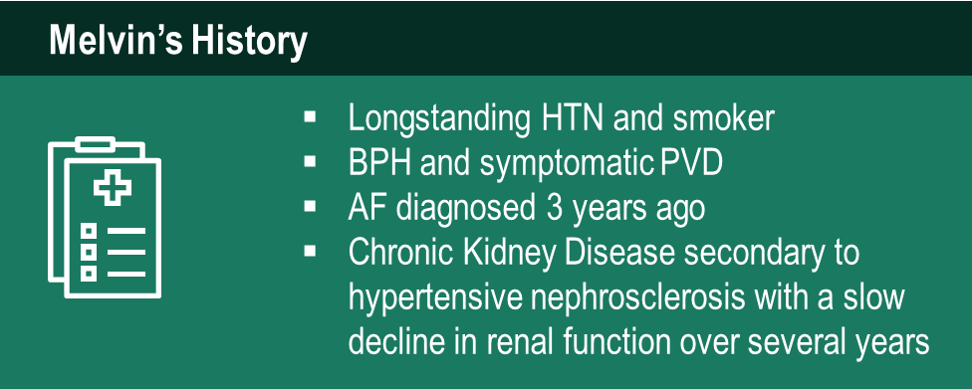

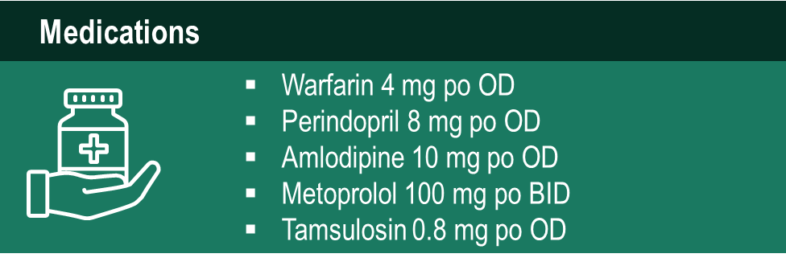
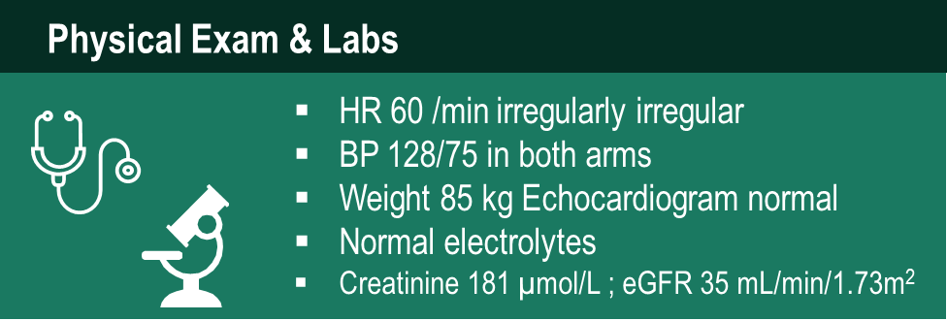
Case 4
Melvin
70 years old
Notes:
Speaker Notes:

Slide 4
Case 4
Melvin
70 years old
Melvin is becoming wearier of having blood work done regularly to monitor his INR and is keen to see if he qualifies for a different medication
Notes:
Speaker Notes:

Slide 5
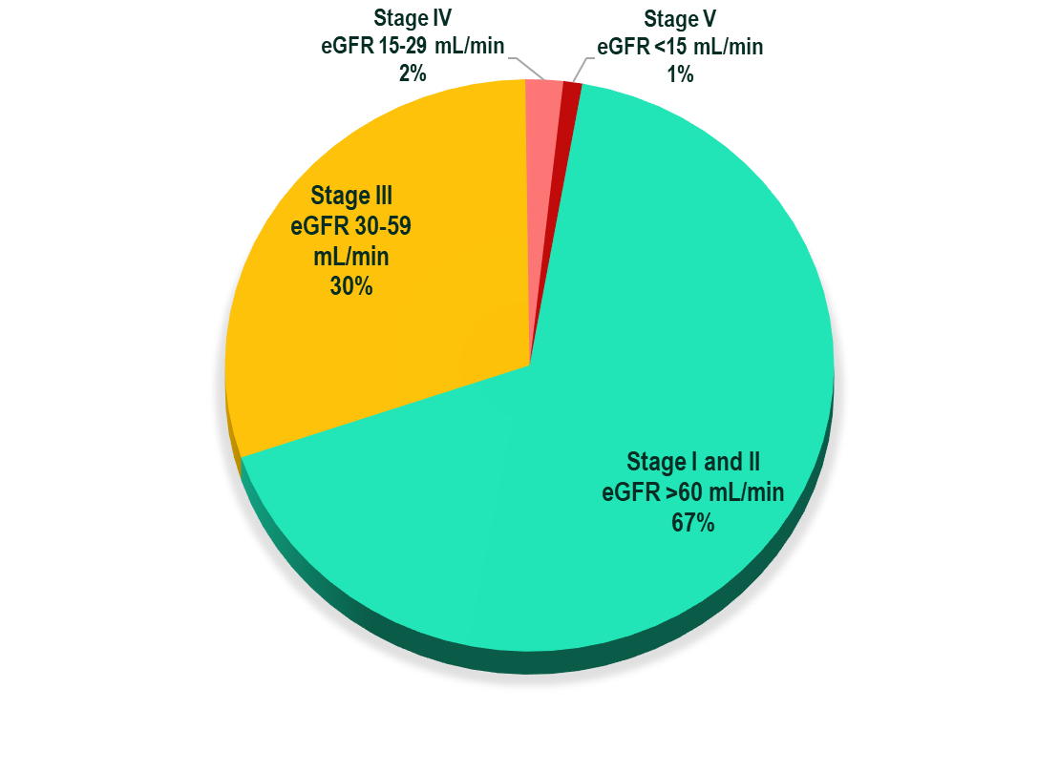
Patients with AF and Moderate Renal Impairment
1/3 patients with AF have CKD¹
Prevalence of both AF and CKD increase with age²
Frequency of CKD in AF Patients¹
Hart et al. Can J Cardiol. 2013;29:S71–78;
Olesen et al. N Engl J Med. 2012;367:625–35.
Notes:
Speaker Notes:
Renal impairment is common in patients with atrial fibrillation, with approximately 30% of these patients having moderate renal impairment.

Slide 6
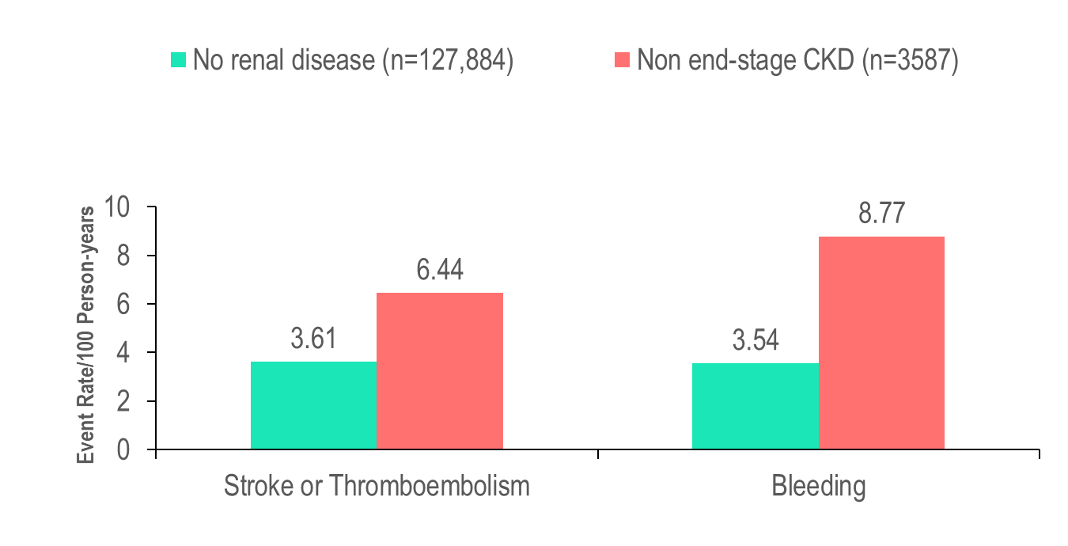
CKD is a Risk Factor for Thrombotic and Bleeding Events
Patients with AF and renal impairment ( compared to no renal impairment):*
Have a higher risk of bleeding¹
Have a higher risk of stroke¹
Are more often undertreated with warfarin²
*vs. normal renal function.
Olesen et al. N Engl J Med. 2012;367:625–35;
Capodanno et al. Circulation. 2012;125:2649–61.
Notes:
Speaker Notes:
Chronic kidney disease is a risk factor for thrombotic and bleeding events, with greater increases in stroke and systemic embolism (3.61 vs. 6.44 events/100 person-years; hazard ratio: 1.49; 95% CI: 1.38-1.59) and bleeding (3.54 vs. 8.77 events/100 person-years; hazard ratio: 2.24; 95% CI: 2.10-2.38) for patients with no renal disease compared to those with non-end-stage chronic kidney disease.

Slide 7
Estimating Renal Function
May be estimated with:
Modification of Diet in Renal Disease (MDRD) equation (eGFR)
Chronic Kidney Disease Epidemiology Collaboration (CKD-EPI) equation (eGFR)
Cockcroft-Gault (C-G) equation, which estimates creatinine clearance (CrCl)
Cockcroft-Gault using actual body weight, used in all phase 3 direct oral DOAC trials
Levey AS. Ann Intern Med. 2006;145:247-254 14. Levey AS. Ann Intern Med. 2009;150:604-612 15. Cockroft DW. Nephron. 1976;16: 31-41
Michels WM. Clin J Am Soc Nephrol. 2010;5:1003-1009 . Connolly SJ. N Engl J Med. 2009;361: 1139-1151 Patel MR. N Engl
J Med. 2011;365:883-891 19. Granger CB. N Engl J Med. 2011;365: 981-992 20. Giugliano RP. N Engl J Med. 2013;369:2093-2104.
Notes:
Speaker Notes:

Slide 8
Kidney Function Calculations Backgrounder
Multiple formulae have been developed to provide an accurate estimate of renal function.
The most commonly applied formulae estimate creatinine clearance (CrCl) or filtration of creatinine by the glomerulus (estimated glomerular filtration rate [GFR] or eGFR).
While the eGFR equations (Modification of Diet in Renal Disease (MDRD) formula or the Chronic Kidney Disease (CKD) Epidemiology Collaboration (CKD- EPI) formula) are more accurate estimates of renal function, drug manufacturers have used the CrCl (Cockcroft-Gault formula) when recommending medication dosage adjustments for patients with renal dysfunction.
*Clin J Am Soc Nephrol 2010;5:1003–1009.
Notes:
Speaker Notes:

Slide 9
Estimating Renal Function
Renal function cutoffs varied between trials
Calculated CrCl ≤ 30 mL/min for dabigatran
Calculated CrCl <30 mL/min for edoxaban and rivaroxaban,
Serum creatinine >2.5 mg/dL (221 µmol/L) or a calculated CrCl of <25 mL/min for apixaban
Use of equations other than Cockcroft-Gault may result in incorrect DOAC dosing
Large database study showed renal function estimations other than Cockcroft-Gault would result in failure to reduce rivaroxaban or edoxaban doses in 28% of
patients, and 18%-21% of doses among dabigatran patients.
Connolly SJ. N Engl J Med. 2009;361: 1139-1151 18. Patel MR. N Engl J Med. 2011;365:883-891
Granger CB. N Engl J Med. 2011;365: 981-992 20. Giugliano RP. N Engl J Med. 2013;369:2093-2104 23. Schwartz JB. J Am Geriatr Soc. 2016;64:1996-2002.
Notes:
Speaker Notes:

Slide 10
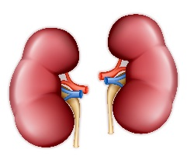
Chronic Renal Insufficiency and
Atrial Fibrillation
Renal Function ↓
Ischemic events↑¹
Hemorrhage ↑²
-- -
Warfarin
+ + vs +++
Accumulation
DOAC
Balancing Risk and Benefit
Nakagawa K, et al. Am J Cardiol 2011;107:912
Lip GY, et al. JACC 2011;57:173-189.
Notes:
Speaker Notes:
As renal function decreases, risk of ischemic events increases as well as risk of severe hemorrhages
Because of NOACs accumulate in renal disease, the bleeding risk further increases and there may be a point where the risk of bleeding outweighs the benefit of NOACs over Warfarin in preventing ischemic stroke SC member opinion

Slide 11
How Often Should We Measure Renal Function?
For patients with renal dysfunction, kidney function should be measured:
eGFR of 15-30 ml/min/1.73 m²: every 3 months
eGFR of 30-60 ml/min/1.73 m² : every 6 months
eGFR of > 60 ml/min/1.73 m² : every 12 months
Canadian Journal of Cardiology; 2015:31;1207-1218
Notes:
Speaker Notes:
Initiation of DOAC is not generally recommended in Canada below an eGFR of 30 ml/min/1.73 m^{2.} However, some AF patients with CRF have period of acute exacerbation when their GFR drops transiently below 30 ml/min/1.73m². Since some DOACs have a low renal elimination rate (e.g. apixaban = 25%), many will feel comfortable continuing them in this setting while carefully monitoring renal function at least every 3 months or even more frequently in some cases. The reasoning is that there is an even greater risk of bleeding on warfarin in stage 4-5 CRF than on a DOAC with low renal clearance. It is important for the speaker to highlight that the foregoing is based on the pharmacokinetic properties of DOACs and that these advanced renal failure patients with low GFR under 25 ml/min/1.73 m² were excluded from the pivotal DOAC vs warfarin trials. (AUTHOR’S OPINION)

Slide 12

Case 4
Before you decide on what additional OAC options there are for Melvin … let calculate his CrCl
Notes:
Speaker Notes:

Slide 13


Let’s Calculate Melvin’s CrCl
Calculated Creatinine Clearance
(Cockcroft and Gault Formula)
Serum creatinine (µmol/l) | 181
Age (years) | 70
Weight (kg) | 85
Sex (m or f) | M
Creatinine clearance (mL/min) 40
Formula:
{(140 - Age) x wt (kg) x F} / (Plasma Creatinine * 0.8136) http://www.sydpath.stvincents.com.au/other/CalcsCrClCGumol.htm
Where F = 1 if male, and 0.85 if female
Notes:
Speaker Notes:

Slide 14
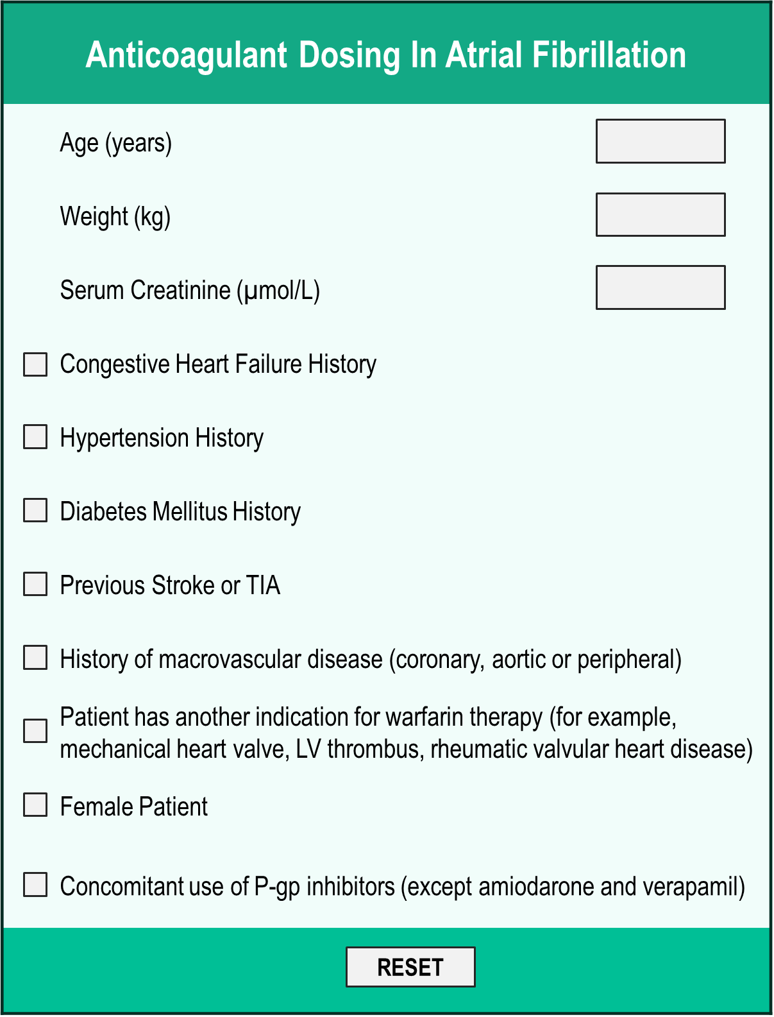
Anticoagulant Dosing In Atrial Fibrillation Tool – Thrombosis Canada
https://thrombosiscanada.ca/tools/
Notes:
Speaker Notes:
Recommendations
Warfarin to achieve INR between 2-3
Apixaban 5 mg twice daily
Dabigatran 150 mg twice daily, may be reduced to 110 mg twice daily if other risks for bleeding exist
Rivaroxaban 15 mg once daily
Edoxaban 30 mg once daily
Other Recommendations:
Creatinine clearance should be checked yearly if creatinine clearance is ≥ 50 mL/min and every 6 months if <50 and drug selection and dose should be reassessed accordingly. The Canadian Cardiovascular Society recommends a novel oral anticoagulant over warfarin (High-Quality Evidence).

Slide 15
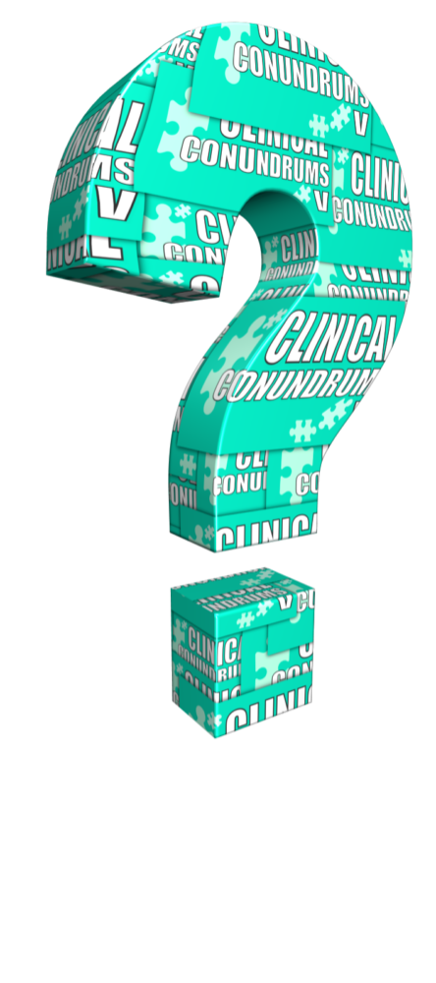
What additional options does Melvin qualify for (CrCl 40 mL/min)?
Select from one or more of the available options
No change, let Melvin know warfarin is the safest option for his stage of chronic kidney disease
Switch to Dabigatran 150 mg BID
Switch to Dabigatran 110 mg BID
Switch to Apixaban 5 mg BID
Switch to Apixaban 2.5 mg BID
Switch to Edoxaban 60 mg OD
Switch to Edoxaban 30 mg OD
Switch to Rivaroxaban 20 mg OD
Switch to Rivaroxaban 15 mg OD
Notes:
Speaker Notes:
Correct answers are 3. 4. 7. and 9.
The percentage varies from 9% after 6 months of monitoring (Sanna et al. Cristal AF. NEJM 2014;370:2478) and 15% at 1-month monitoring (Gladstone et al.) to 43% after 30.5 months of follow-up (Ntaios G et al. Stroke 2015;46:176).

Slide 16
Stroke Prevention in AF: Clinical Pharmacology and Dosing of DOACs
 | Apixaban | Dabigatran | EDOXABAN | Rivaroxaban
Mechanism of action | Direct Factor Xa inhibitor | Direct thrombin inhibitor | Direct Factor Xa inhibitor | Direct Factor Xa inhibitor
Oral bioavailability | ~50% | ~6.5% | 62% | 80-100%
Pro-drug | No | Yes | No | No
Food effect | No | No | No | Yes (needs to be taken with food)
Renal clearance | ~27% | 85% | 50% | 36% *
Mean half-life (t_{1/2}) | ~12 h | 11-17h | 10-14h | 5-13 h
T_{max} | 3-4 h | 0.5-2 h | 1-2h | 2-4 h
Recommended daily dose | 5 mg BID | 150 mg BID | 60 mg QD | 20 mg QD
Pfizer Canada Inc./BMS Canada. Eliquis (apixaban) Product Monograph, June 16, 2016.
Boehringer Ingelheim Canada Ltd. Pradaxa (dagbatran) Product Monograph. August 11, 2016.
Bayer Inc. Xarelto (rivaroxaban) Product Monograph. July 20, 2015.
Daiichi Sankyp Inc. Lixiana (edoxaban) Product Monograph. November 2, 2016.
* Rivaroxaban is 66% renally cleared and its active metabolite is 36% renally cleared
Notes:
Speaker Notes:
DOACs can be differentiated based on efficacy and bleeding risk in the clinical trials ( and real-world experience available and forthcoming…) with the limitations of indirect clinical comparisons duly acknowledged. DOACs can also be differentiated based on other factors as summarized in this slide. Parameters such as borderline renal function, sensitivity to dyspepsia, irregular food intake, need for blister pack medication preparation by pharmacist, cognitive dysfunction and medication non compliance to BID dosing etc etc can determine selection of the best agent for a given patient!
The Tmax of all DOACs is a short 2-4 hours. This means that, unlike with warfarin, a patient is rapidly anticoagulated within just two hours following a DOAC dose. This has important implications for heparin “bridging” which is no longer required with DOACs as well as for the timing of resumption of DOAC therapy following procedures.
All DOACs share a short 12 hour half-life in the setting of preserved renal function (CrCl > 60 ml/min). This is a major advantage over warfarin which has a half-life of 36 hours or longer depending on hepatic function. Most procedures at intermediate or high bleeding risk can be performed within 1-2 days respectively of withholding a DOAC with additional delay required with renal dysfunction. Moreover, major bleeding can usually be controlled with local and supportive measures as the effect of the DOAC wears off quickly. Specific DOAC antidotes are therefore rarely required.

Slide 17
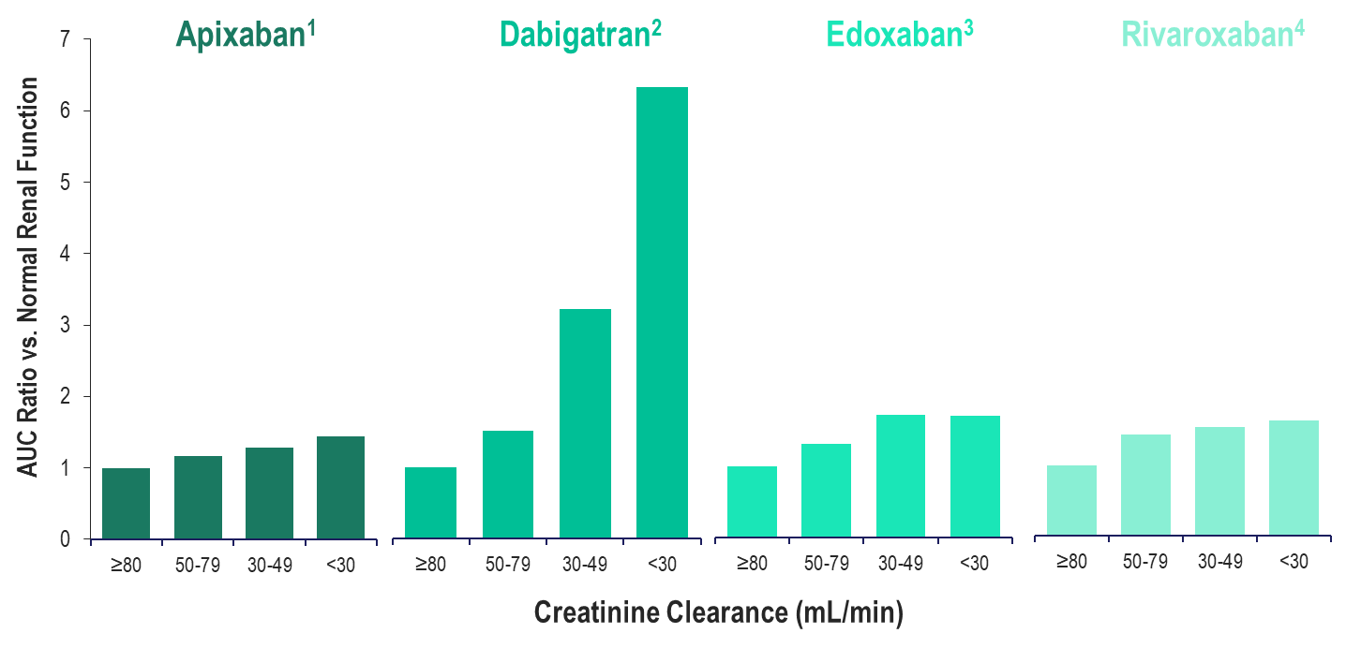
Total Drug Exposure (AUC) with Declining Renal Function
CL_{R}27%
CL_{R}85%
CL_{R}50%
CL_{R}33%
Normal Renal Function: ≥80 mL/min; Mild Renal Impairment: 50-79 mL/min
Moderate Renal Impairment: 30-49 mL/min; Severe Renal Impairment: <30 mL/min
Apixaban (Eliquis) Product Monograph. Bristol-Meyers Squibb Canada;
Dabigatran (Pradaxa) Product Monograph. Boehringer Ingelheim Canada Ltd.;
Edoxaban (Lixiana) Product Monograph. Progress Therapeutics;
Rivaroxaban (Xarelto) Product Monograph. Bayer Inc.
Notes:
Speaker Notes:
DOACs can be differentiated based on efficacy and bleeding risk in the clinical trials ( and real-world experience available and forthcoming…) with the limitations of indirect clinical comparisons duly acknowledged. DOACs can also be differentiated based on other factors as summarized in this slide. Parameters such as borderline renal function, sensitivity to dyspepsia, irregular food intake, need for blister pack medication preparation by pharmacist, cognitive dysfunction and medication non compliance to BID dosing etc etc can determine selection of the best agent for a given patient!
The Tmax of all DOACs is a short 2-4 hours. This means that, unlike with warfarin, a patient is rapidly anticoagulated within just two hours following a DOAC dose. This has important implications for heparin “bridging” which is no longer required with DOACs as well as for the timing of resumption of DOAC therapy following procedures.
All DOACs share a short 12 hour half-life in the setting of preserved renal function (CrCl > 60 ml/min). This is a major advantage over warfarin which has a half-life of 36 hours or longer depending on hepatic function. Most procedures at intermediate or high bleeding risk can be performed within 1-2 days respectively of withholding a DOAC with additional delay required with renal dysfunction. Moreover, major bleeding can usually be controlled with local and supportive measures as the effect of the DOAC wears off quickly. Specific DOAC antidotes are therefore rarely required.

Slide 18
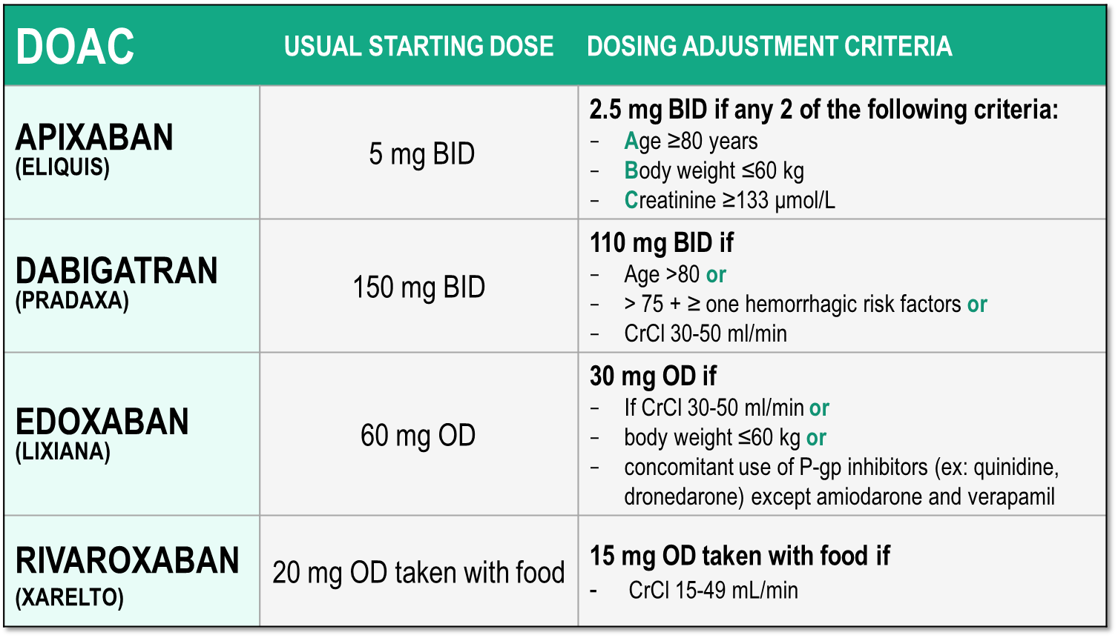
Considerations for Dosing of DOACs
Pfizer Canada Inc./BMS Canada. Eliquis (apixaban) Product Monograph, 2018.
Boehringer Ingelheim Canada Ltd. Pradaxa (dagbatran) Product Monograph. August 11, 2016.
Bayer Inc. Xarelto (rivaroxaban) Product Monograph. 2018.
Daiichi Sankyp Inc. Lixiana (edoxaban) Product Monograph. 2017.

Slide 19
Reviewing the Data: Apixaban
Outcomes in ARISTOTLE According to Renal Function
 | Apixaban | Warfarin | Hazard Ratio (95% CI) | P value Interaction
 | Number of events (%/yr)
Stroke / SE |  |  |  | : 0.705
eCrCl >80 mL/min* | 0.99% (70) | 1.12% (79)
eCrCl >50-80 mL/min† | 1.24% (87) | 1.69% (116)
eCrCl ≤50 mL/min‡ | 2.11% (54) | 2.67% (69)
Major bleeding |  |  |  | : 0.03
eCrCl >80 mL/min* | 1.46% (96) | 1.84% (119)
eCrCl >50-80 mL/min† | 2.45% (157) | 3.21% (199)
eCrCl ≤50 mL/min‡ | 3.21% (73) | 6.44% (142)
N=7,518
0.25
0.5
1.00
1.5
2.0
Apixaban better
Warfarin better
*n=7518 (41%); †n=7587 (42%); ‡n=3017 (17%) Results were consistent regardless of methods for GFR estimation Hohnloser SH et al. Eur Heart J 2012; 22:2821-30.
Notes:
Speaker Notes:
Stroke / SE efficacy advantage of apixaban over warfarin in the Aristotle population was unaffected by renal dysfunction with non significant p value for interaction.
Major bleeding increased (tripled) in both apixaban and warfarin arms the study highlighting the important effect of renal dysfunction on bleeding risk
Apixaban appeared particularly safe vs. warfarin in the subgroup with CrCl < 50 ml/min with a 50% reduction in risk of major bleeding (P value for interaction significant at 0.03)

Slide 20
Reviewing the Data: Dabigatran
Outcomes of Dabigatran 110 mg BID & 150 mg BID in RE-LY According to Renal Function
 | Hazard Ratio (95% CI) Dabi 110 vs. Warfarin | P value Interaction | Hazard Ratio (95% CI) Dabi 150 vs. Warfarin | P value Interaction
Stroke / SE |  | : 0.911 |  | : 0.752
eCrCl ≥80 mL/min*
eCrCl 50-<80 mL/min†
eCrCl <50 mL/min‡
Major bleeding |  | : 0.061 |  | : 0.639
eCrCl ≥80 mL/min*
eCrCl 50-<80 mL/min†
eCrCl <50 mL/min‡
0.25
0.5
1.00
1.5
2.0
0.25
0.5
1.00
1.5
2.0
Dabi 110 better
Warfarin better
Dabi 150 better
Warfarin better
N= 18,113
*n=5844 (32.6%); † n=8553 (47.6%); ‡ n=3554 (19.8%)
Results were consistent regardless of methods for GFR estimation Hijazi Z et al. Circulation 2014; 129:961-70.
Notes:
Speaker Notes:
Both dosages of dabigatran were tested against warfarin in RELY regardless of renal function down a CrCl of 30 ml/min
There was no interaction for efficacy OR major bleeding safety with either dosage tested and tertiles of renal function as shown in the slide.

Slide 21
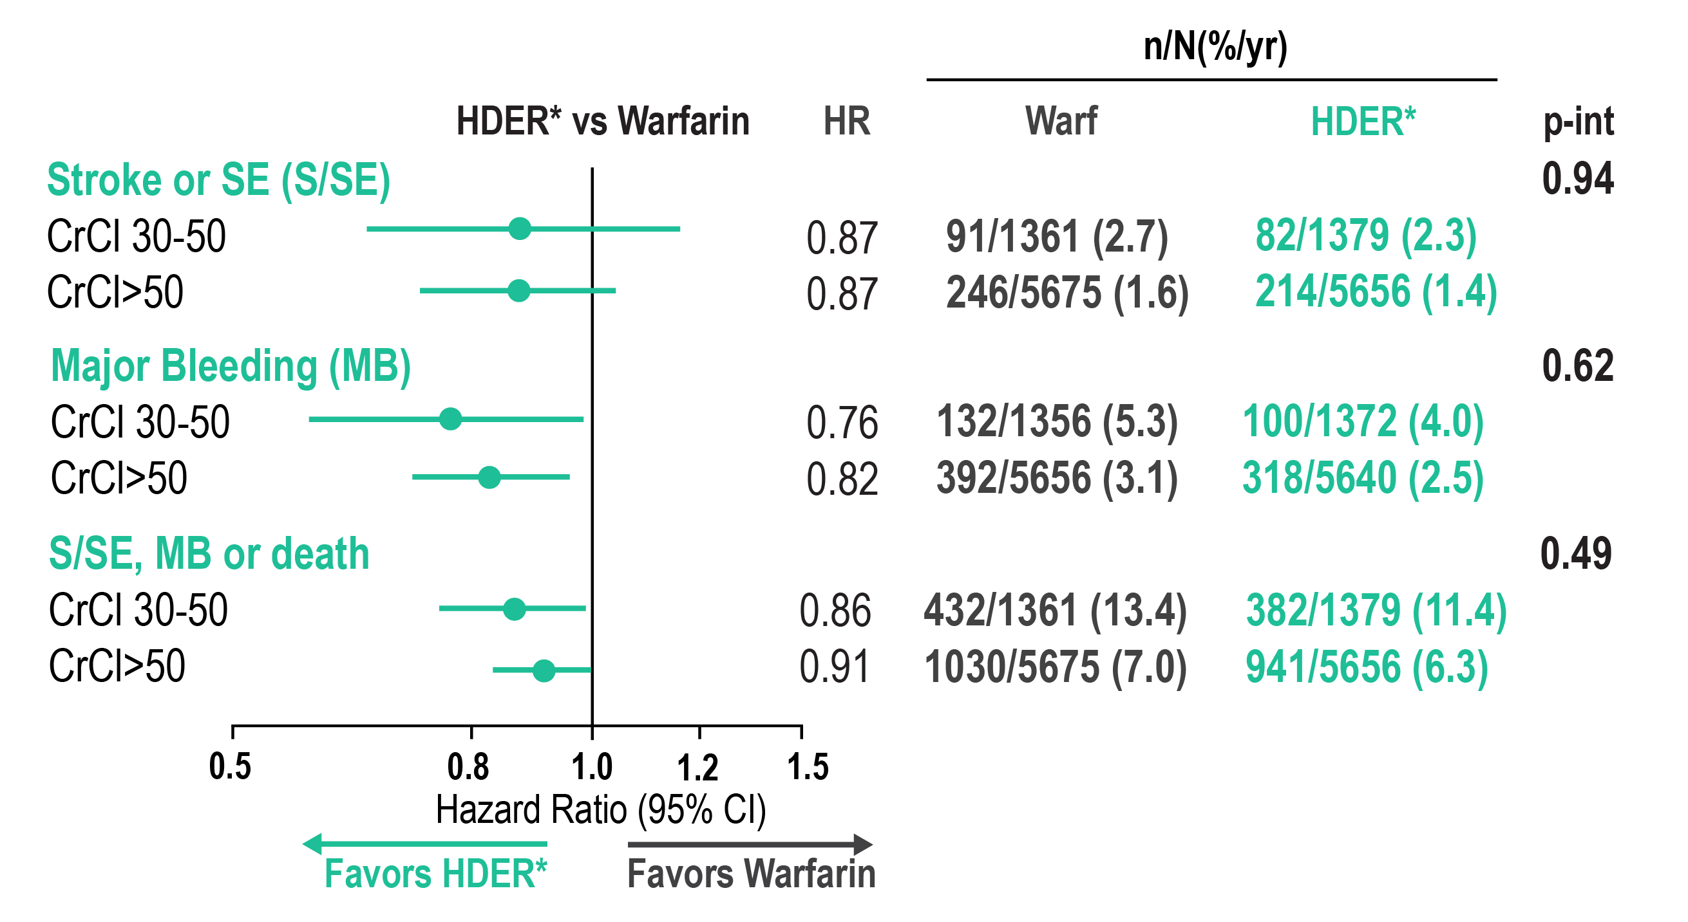
Reviewing the Data: Edoxaban
Outcomes in the ENGAGE AF-TIMI 48 Trial According to Renal Function
*HDER of 60 mg daily or 30 mg daily if dose reduced for creatinine clearance (CrCl) ≤50 mL/min, weight ≤60 kg, or potent phosphorylated glycoprotein inhibitor use.
Impact of Renal Function on Outcomes With Edoxaban in the ENGAGE AF-TIMI 48 Trial, Volume: 134, Issue: 1, Pages: 24-36, DOI: (10.1161/CIRCULATIONAHA.116.022361)
Notes:
Speaker Notes:
Data for the efficacy and net clinical outcome analyses are from the intention-to-treat population for the overall study period. Data for safety are from the safety cohort for the treatment period with interval censoring of events during study-drug interruptions that lasted >3 days. CrCl (mL/min) at randomization was estimated with the Cockcroft-Gault equation. CI indicates confidence interval; HDER, higher-dose edoxaban regimen; HR, hazard ratio; P-int, P for interaction for treatment by renal subgroup; and S/SE, stroke or systemic embolism. *HDER of 60 mg daily or 30 mg daily if dose reduced for creatinine clearance (CrCl) ≤50 mL/min, weight ≤60 kg, or potent phosphorylated glycoprotein inhibitor use.

Slide 22
Reviewing the Data: Rivaroxaban
Outcomes in ROCKET-AF According to Renal Function
 | Rivaroxaban | Warfarin | Hazard Ratio (95% CI) | P value Interaction
 | Number of events per 100 pt-yrs
Stroke / SE |  |  |  | : 0.76
eCrCl ≥50 mL/min* | 1.57 | 2.00
eCrCl 30-49 mL/min† | 2.32 | 2.77
Major bleeding |  |  |  | : 0.48
eCrCl ≥50 mL/min* | 3.39 | 3.17
eCrCl 30-49 mL/min† | 4.49 | 4.70
0.25
0.5
1.00
1.5
2.0
N= 14,264
Rivaroxaban better
Warfarin better
*rivaroxaban 20 mg (n=5637; 79%); †rivaroxaban 15 mg (n=1474; 21%); per protocol population Fox KAA et al. Eur Heart J 2011; 32:2387-94
Notes:
Speaker Notes:
- There was no interaction for stroke/SE efficacy OR major bleeding safety with rivaroxaban vs. warfarin with reduced renal function, dosage adjusted to 15 mg daily at CrCl < 50 ml/min.

Slide 23
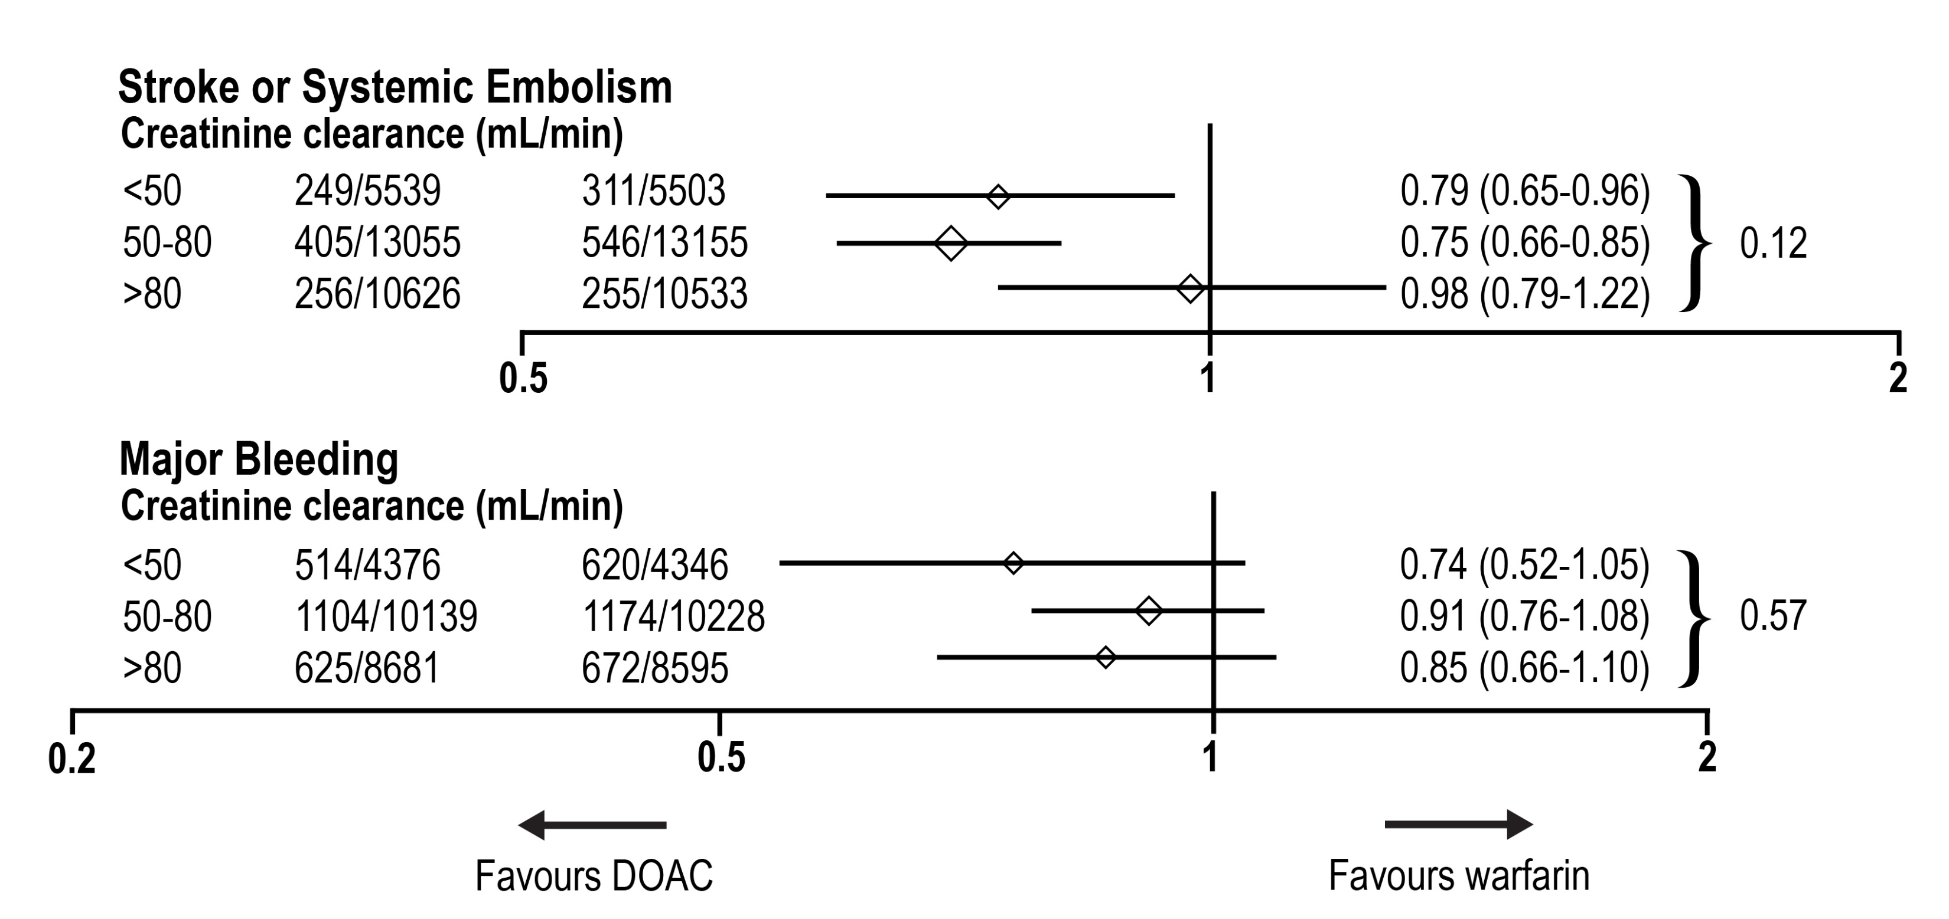
DOACs may be more Effective in Moderate CKD: Stroke Prevention
Lancet 2014; 383: 955–62
Notes:
Speaker Notes:

Slide 24
Case 4
It’s 3 years later.
Melvin is now 73 years old and his CrCl is 20 mL/min
Notes:
Speaker Notes:

Slide 25
How would you adjust Melvin’s anticoagulation strategy for his atrial fibrillation (CrCl 20 mL/min)?
Select from one or more of the available options
Let Melvin know warfarin is the safest option for his stage of chronic kidney disease
Use Dabigatran 150 mg BID
Use Dabigatran 110 mg BID
Use Apixaban 5 mg BID
Use Apixaban 2.5 mg BID
Use Edoxaban 60 mg OD
Use Edoxaban 30 mg OD
Use Rivaroxaban 20 mg OD
Use Rivaroxaban 15 mg OD
Notes:
Speaker Notes:
Possible correct responses include 1. 4. and 9. A discussion of benefit vs risk is needed with the patient
The percentage varies from 9% after 6 months of monitoring (Sanna et al. Cristal AF. NEJM 2014;370:2478) and 15% at 1-month monitoring (Gladstone et al.) to 43% after 30.5 months of follow-up (Ntaios G et al. Stroke 2015;46:176).

Slide 26
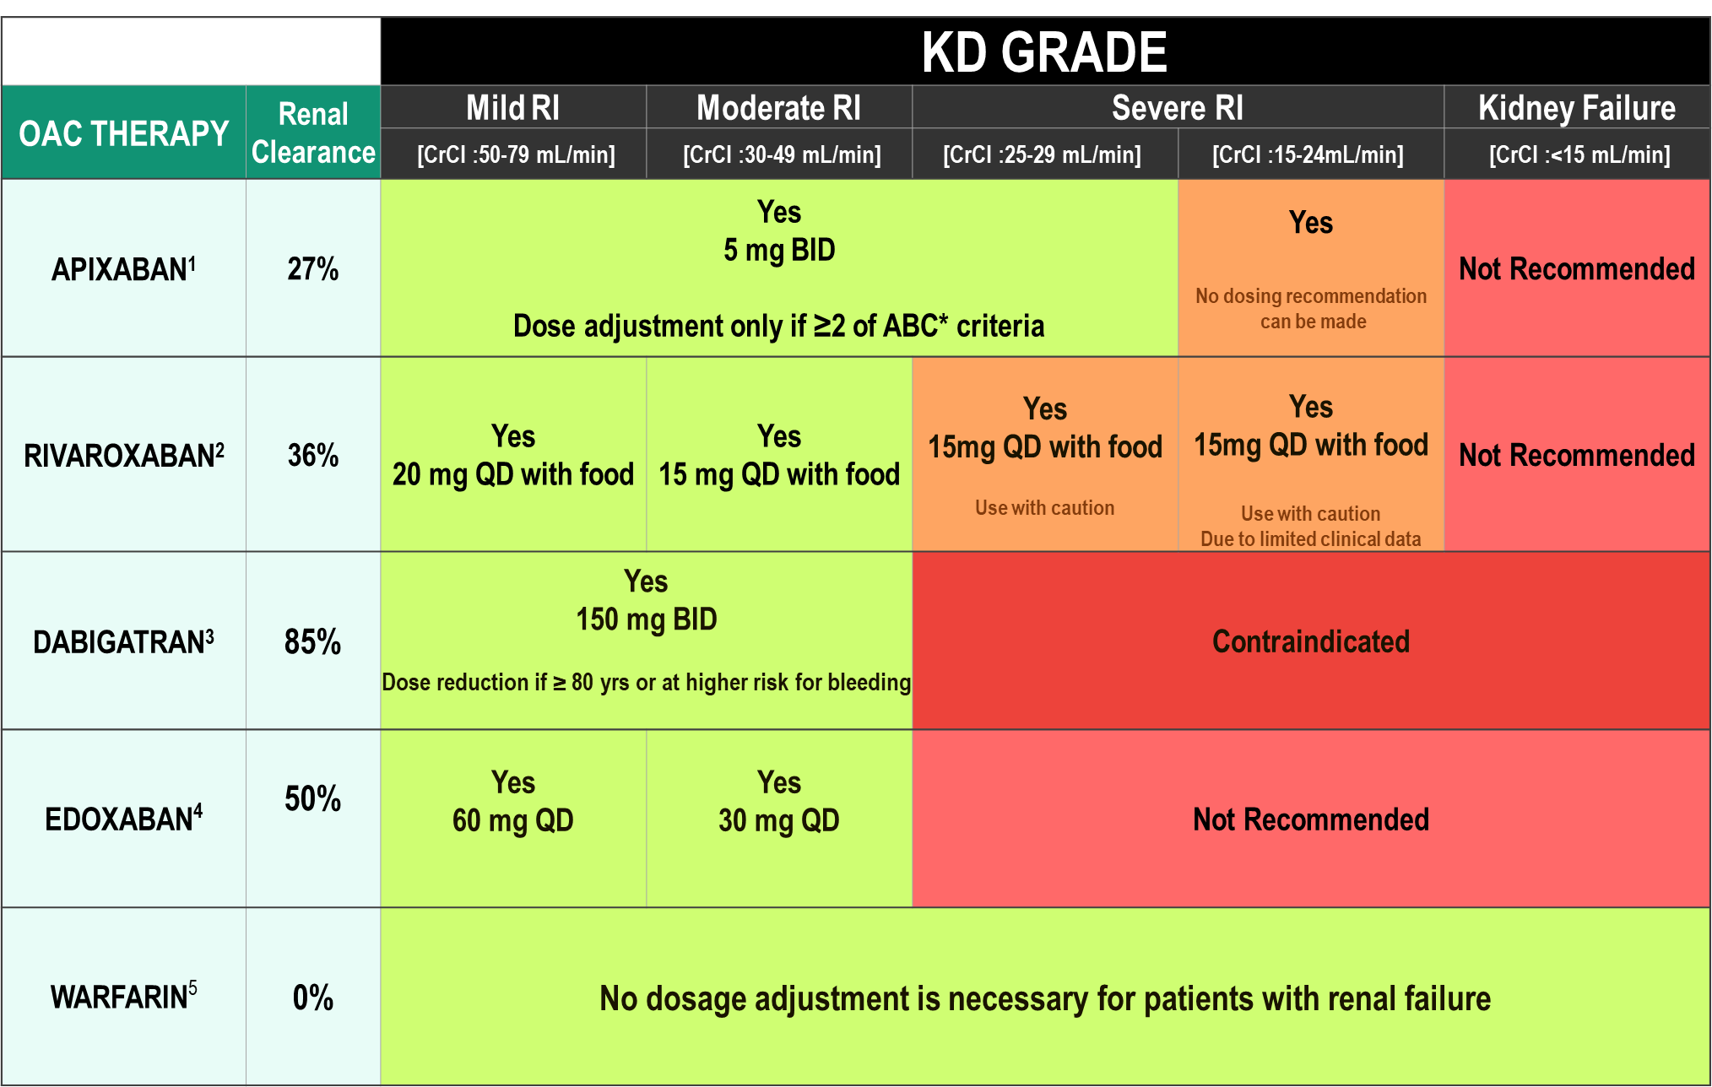
DOAC Dosing Recommendations for Stroke Prevention in AF in Patients with Renal Impairment According to the Canadian Product Monographs
Pfizer Canada Inc./BMS Canada. Eliquis (apixaban) Product Monograph, 2018.
Boehringer Ingelheim Canada Ltd. Pradaxa (dagbatran) Product Monograph. August 11, 2016.
Bayer Inc. Xarelto (rivaroxaban) Product Monograph. 2018.
Daiichi Sankyp Inc. Lixiana (edoxaban) Product Monograph. 2017.

Slide 27
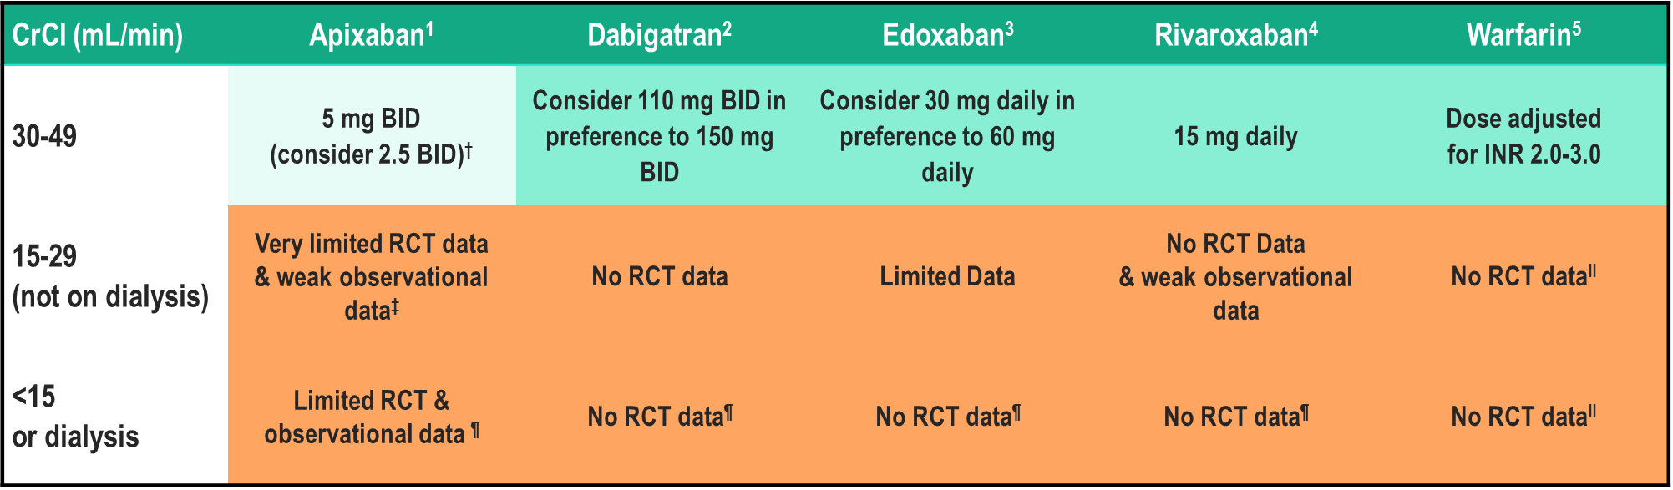
Limited evidence for DOACs in AF patients with Advanced (stages 4-5) CRF
Pfizer Canada Inc./BMS Canada. Eliquis (apixaban) Product Monograph, 2018.
Boehringer Ingelheim Canada Ltd. Pradaxa (dagbatran) Product Monograph. August 11, 2016.
Bayer Inc. Xarelto (rivaroxaban) Product Monograph. 2018.
Daiichi Sankyp Inc. Lixiana (edoxaban) Product Monograph. 2017.
Notes:
Speaker Notes:
The DOACs are at least partially eliminated by the kidneys. Dabigatran and edoxaban have the greatest dependence on renal elimination (~85% and 50%, respectively),^{8, 9} whereas 27% and 33% of apixaban and rivaroxaban, respectively, are renally cleared as unchanged drug.

Slide 28
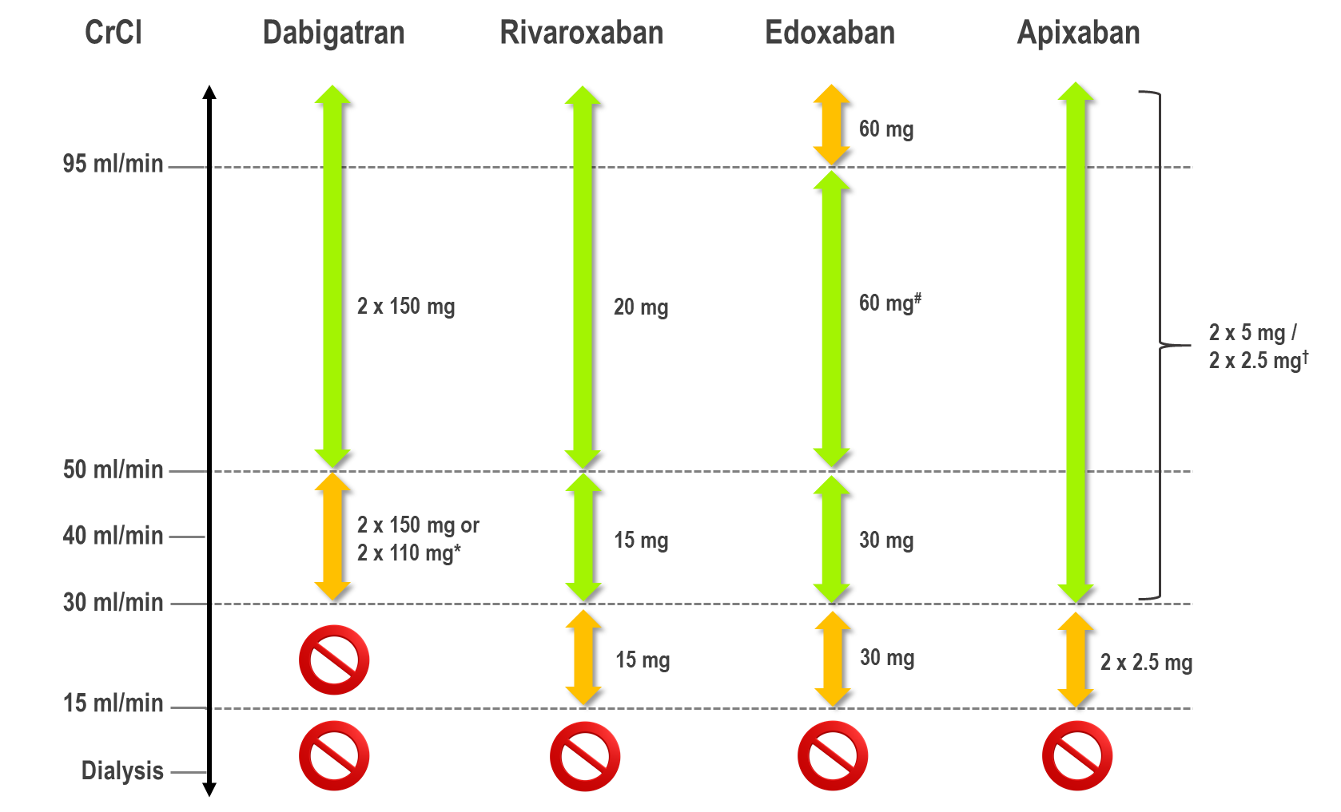
The 2018 European Heart Rhythm Association
Practical Guide on the Use Of DOACs in Patients
with Atrial Fibrillation
Steffel J. et al; European Heart Journal (2018) 39, 1330–1393
Notes:
Speaker Notes:
Use of non-vitamin K antagonist oral anticoagulants according to renal function. *2x 110 mg in patients at high risk of bleeding (per SmPc). # Other dose reduction criteria may apply (weight ≤60 kg, concomitant potent P-Gp inhibitor therapy) † 2x 2.5 mg only if at least two out of three fulfilled: age ≥80 years, body weight ≤60 kg’ creatinine ≥1.5 mg/dL (133 mmol/L). Orange arrows indicate cautionary use (dabigatran in moderate renal insufficiency, FXa inhibitors in severe renal insufficiency, edoxaban in ‘supranormal’ renal function);
Oral anticoagulant therapy in patients with a CrCl of 15–29 mL/min
There are no RCT data on the use of DOACs for stroke prevention in AF patients with severe CKD or on renal replacement therapy (RRT) since all landmark DOACs trials essentially excluded patients with a CrCl of <30 ml/min (except for a few patients on apixaban with CrCl 25–30 mL/min). However, VKA have also never been prospectively assessed in a RCT in this patient population
Rivaroxaban, apixaban, and edoxaban (but not dabigatran) are approved in Europe for the use in patients with severe CKD (Stage 4, i.e. a CrCl of 15–29 mL/min), with the reduced dose regimen. In view of the individual DOACs’ pharmacokinetics, dose-reduction criteria and available evidence from RCTs, the use of either apixaban or edoxaban may be preferable in these patients. Apixaban is least renally cleared (27%), and the dose is reduced by 50% in rather stringent conditions according to its dose reduction algorithm; furthermore the relative safety of apixaban vs. warfarin has been demonstrated to increase with decreasing renal function. Edoxaban is 50% renally cleared, but its dose reduction to 50% is applied more rapidly and was tested in a large subgroup. Rivaroxaban has an intermediate renal clearance (33%), and its dose is reduced less (by 25%) under similar conditions as edoxaban. In the US (but not in Europe), a low dose dabigatran 75 mg BID regimen has been approved for patients with severe CKD (a CrCl of 15–29 mL/ min), based on pharmacokinetic simulations. Further randomized trial data are urgently required for these difficult to treat patients.

Slide 29
Case 4
Another 3 years later. Melvin is now 76 years old and his CrCl is < 15 mL/min
Melvin feels well and is not receiving renal replacement therapy.
Notes:
Speaker Notes:

Slide 30
How would you adjust Melvin’s anticoagulation strategy for at this point (CrCl <15 mL/min)?
Select from one or more of the available options
Let Melvin know Warfarin is the safest option for his stage of chronic kidney disease
Use Dabigatran 150 mg BID
Use Dabigatran 110 mg BID
Use Apixaban 5 mg BID
Use Apixaban 2.5 mg BID
Use Edoxaban 60 mg OD
Use Edoxaban 30 mg OD
Use Rivaroxaban 20 mg OD
Use Rivaroxaban 15 mg OD
Do not use any anticoagulation as Melvin’s bleeding risk outweighs his risk of a cardioembolic event
Notes:
Speaker Notes:

Slide 31
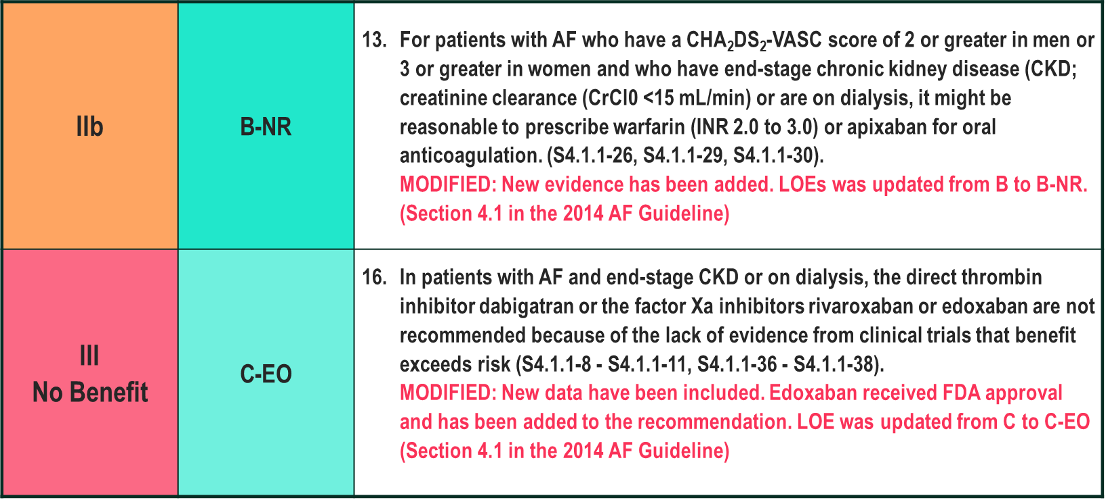
2019 AHA/ACC/HRS Focused Update of the 2014 AHA/ACC/HRS Guideline for the Management of Patients With Atrial Fibrillation
AHA/ACC/HRS focused update of the 2014 AHA/ACC/HRS guideline for the management of patients with atrial fibrillation: a report of the American College of Cardiology/American Heart Association Task Force on Clinical Practice Guidelines and the Heart Rhythm Society. Circulation. 2019;139:
.
Notes:
Speaker Notes:

Slide 32
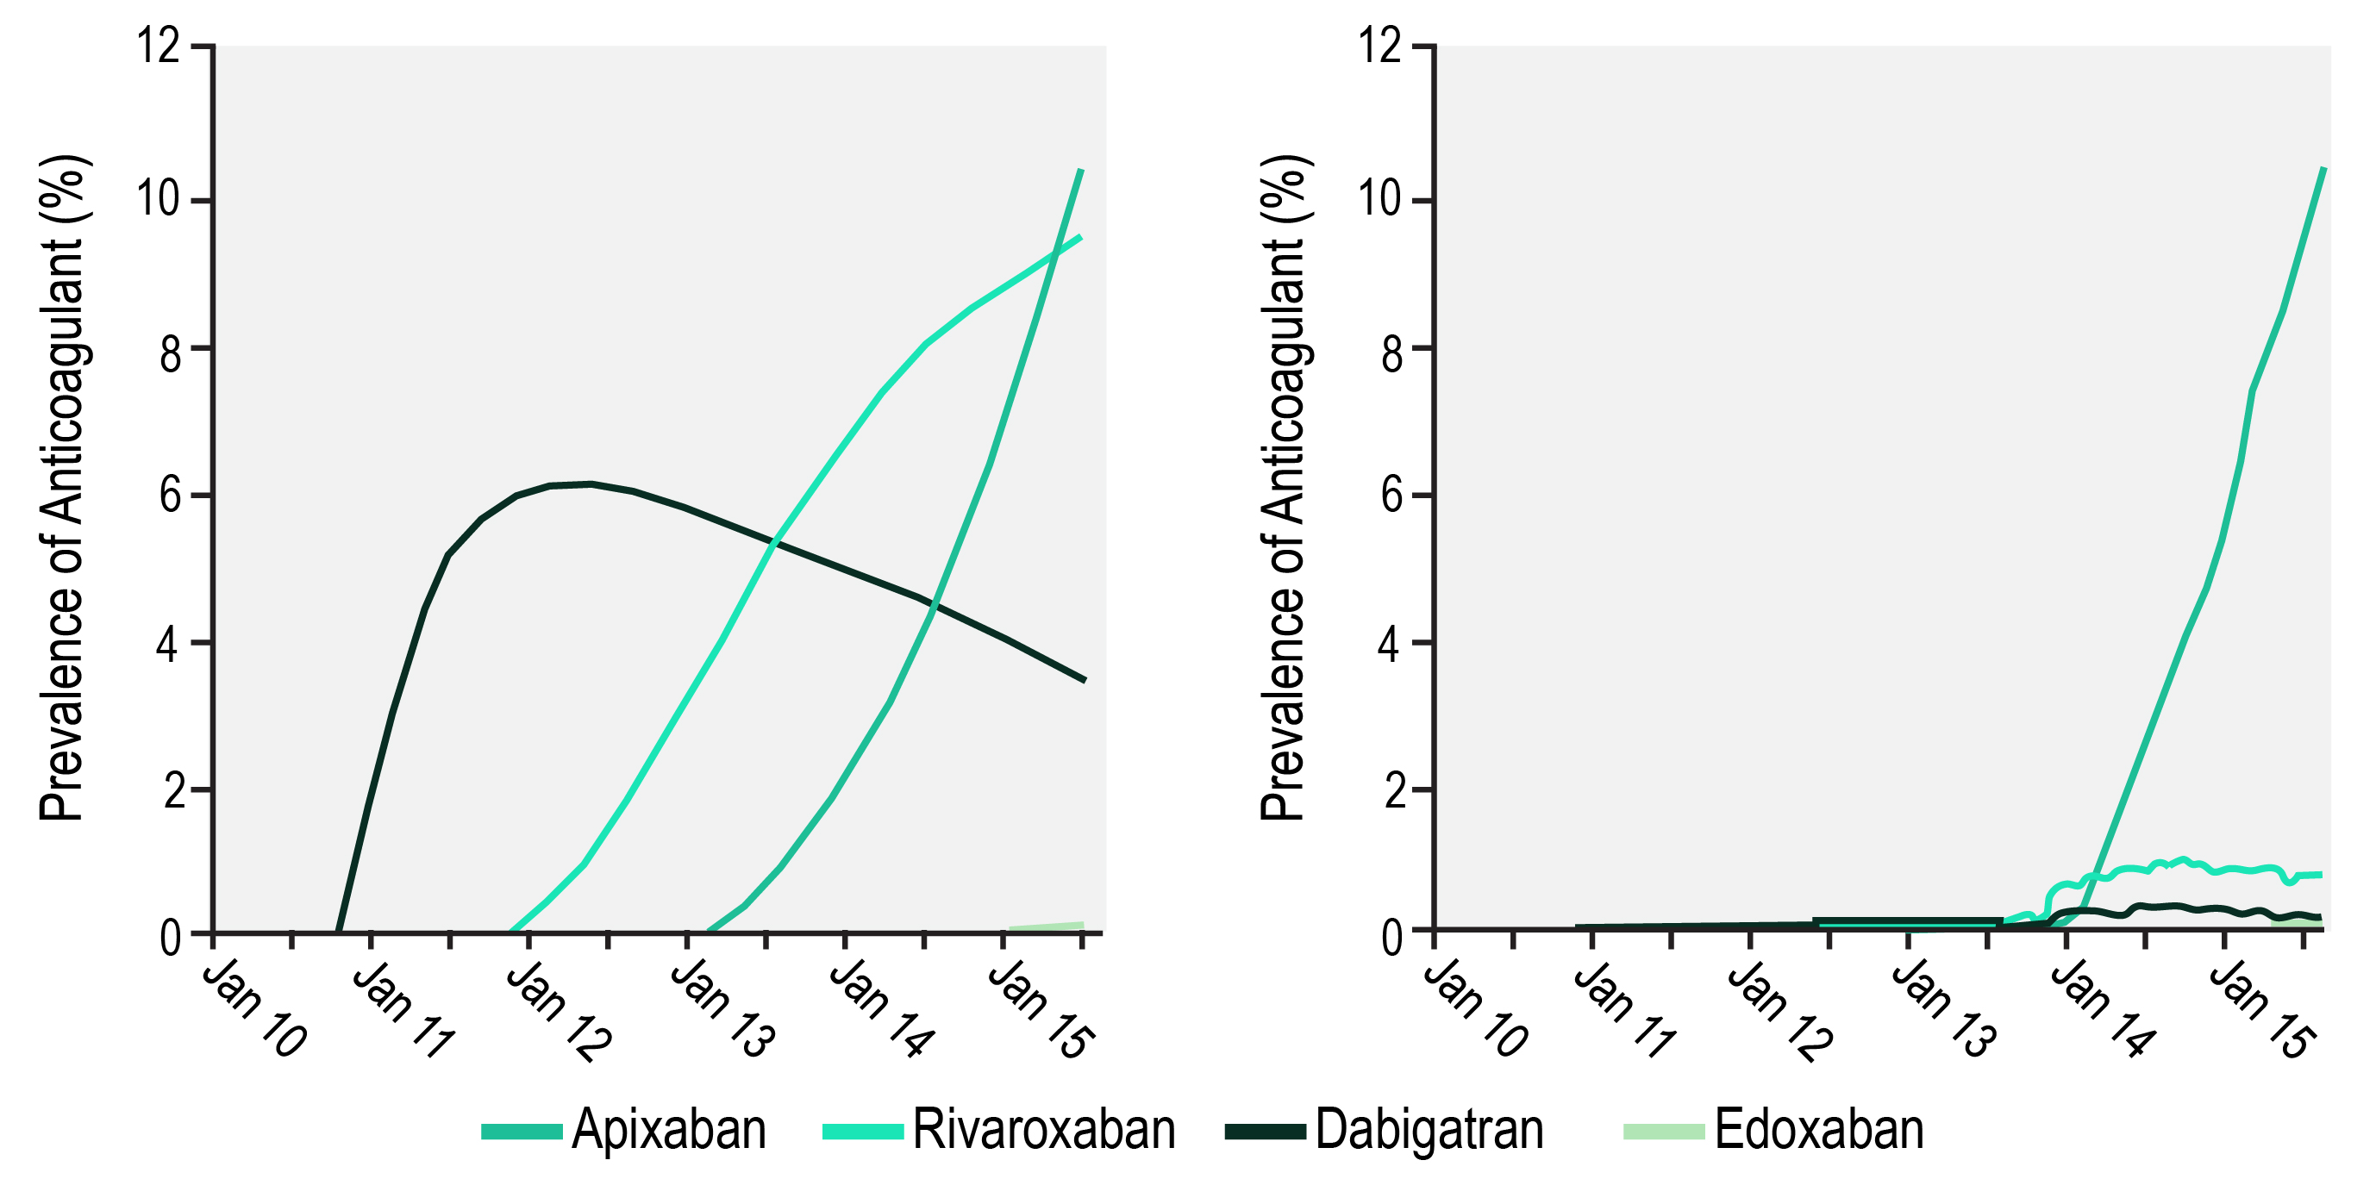
Use of Nonvitamin K-Dependent Oral Anticoagulant Agents in Patients With Advanced Chronic Kidney Disease and on Dialysis: Substantial and Growing
Advanced Chronic Kidney Disease
(n = 102,504)
Dialysis
(n = 140,918)
Chan, K.E. et al. J Am Coll Cardiol. 2016; 67(24): 2888-99
Notes:
Speaker Notes:
Patients with atrial fibrillation (AF) are increasingly being treated with nonvitamin K-dependent oral anticoagulant agents (DOACs) because these drugs are at least as effective as warfarin, are safer, do not require routine monitoring, and are simpler to use 1, 2, 3, 4, 5. In 2013, DOACs accounted for 62% of new prescriptions of anticoagulant agents in the United States, and their adoption is increasing (1).
Although DOACs hold great promise, they also have drawbacks, such as limited availability of and little experience with reversal agents, as well as higher costs. Currently, all DOACs depend to some extent on renal function for clearance. Consequently, DOACs may potentially accumulate in patients with renal dysfunction, leading to an increased risk for bleeding. Additionally, patients with advanced chronic kidney disease (CKD) (creatinine clearance [CrCl] <30 ml/min) are already at increased risk for bleeding from uremia-induced platelet dysfunction 6, 7. Patients on hemodialysis have added bleeding risks from repeated vascular access cannulation, dialysis membrane interactions, higher than average blood pressures, and considerable heparin administration during treatment. Because patients with advanced CKD and end-stage renal disease(ESRD) were excluded from all of the pivotal phase 3 DOAC trials, no randomized controlled trial data guide DOAC use when the CrCl is <25 ml/min, although the U.S. Food and Drug Administration (FDA) label supports DOAC dosing for patients with CrCl ≤15 ml/min.
The most recent 2014 American Heart Association (AHA), American College of Cardiology (ACC), and Heart Rhythm Society (HRS) guideline for the management of patients with AF recommends warfarin as the anticoagulant agent of choice in patients with advanced CKD or ESRD (8). Despite these recommendations and the lack of prospective trials to validate the efficacy and safety of DOACs in this patient population, the prescription of these drugs is becoming more prevalent, as we showed in our previous publication (9). Our updated analysis (unpublished data from Fresenius Medical Care) indicates that there were 102,504 AF patients with advanced CKD and 140,918 AF patients on dialysis treated with an oral anticoagulant in the Fresenius database. As of October 2015, 23.5% of CKD patients and 11.6% of dialysis patients on anticoagulation were treated with a DOAC (Central Illustration). In advanced CKD, the most commonly used drug was apixaban (10.4%), followed by rivaroxaban (9.5%), dabigatran (3.5%), and edoxaban (0.1%). Among dialysis patients, the most commonly used drug was apixaban (10.5%), followed by rivaroxaban (0.8%), dabigatran (0.3%), and edoxaban (0.01%).

Slide 33
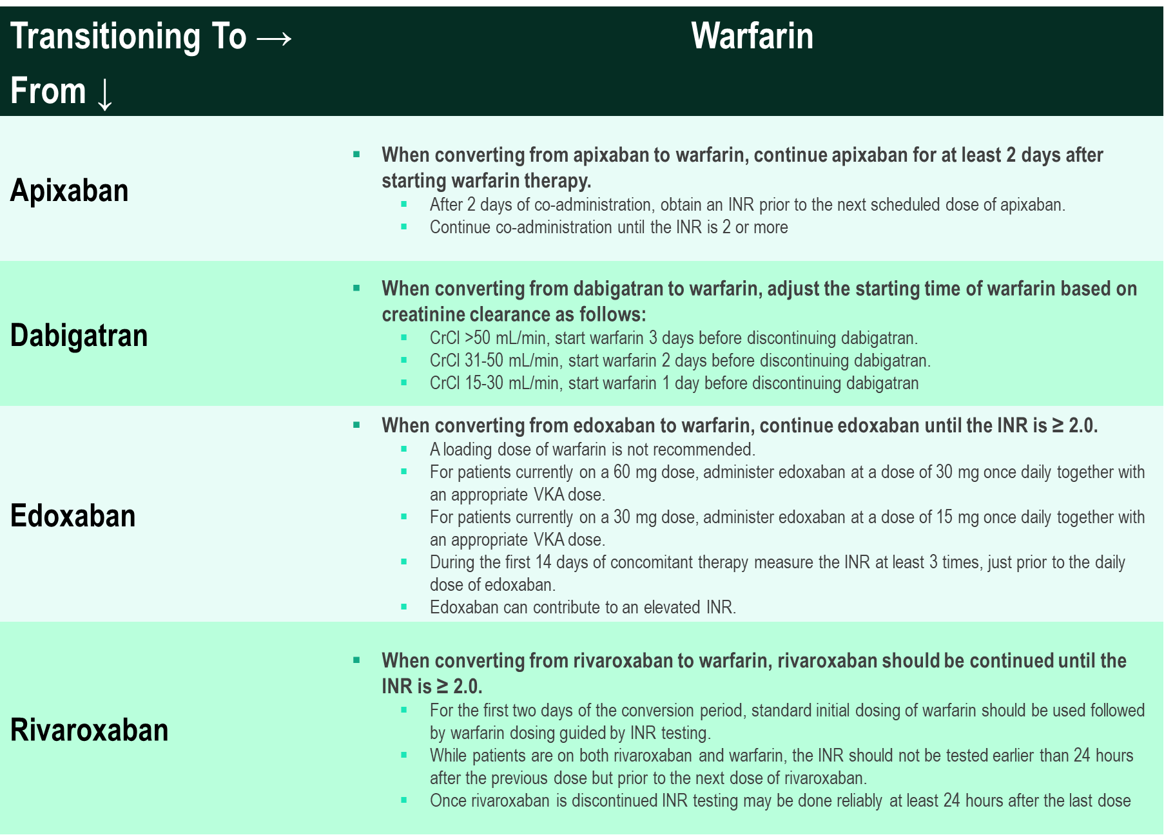
Transitioning from DOACs
to Warfarin
Pfizer Canada Inc./BMS Canada. Eliquis (apixaban) Product Monograph, 2018.
Boehringer Ingelheim Canada Ltd. Pradaxa (dagbatran) Product Monograph. August 11, 2016.
Bayer Inc. Xarelto (rivaroxaban) Product Monograph. 2018.
Daiichi Sankyp Inc. Lixiana (edoxaban) Product Monograph. 2017.
Notes:
Speaker Notes:
Transitioning from a DOAC to warfarin requires bridging.
Encourage the group to review the product monograph prior to switching.

Slide 34
Major Bleeding Rates with Warfarin is Increased in Low CrCl Patients
Kidney Function | Major Bleeding (Events per 100 Patient-Years)
CrCl ≥60 ml/min | 6.2 (4.1–8.9)
CrCl 30–59 ml/min | 8.3 (5.1–12.8)
CrCl <30 ml/min | 30.5 (17.0–50.3)
Dialysis | 54–100
CrCl = creatinine clearance.
Chan, K.E. et al. J Am Coll Cardiol. 2016; 67(24): 2888-99
Notes:
Speaker Notes:
Data from Limdi et al. (17) and Elliott et al. (64).
Warfarin is minimally dependent on the kidney for elimination, such that progression of CKD or acute changes in creatinine can minimally influence anticoagulation levels from the drug. Warfarin has the advantages of clinical familiarity, low cost, and widespread availability of reversal agents. Reversal of warfarin’s anticoagulant effect can be accomplished with vitamin K or fresh-frozen plasma for nonemergent situations, with 4-factor prothrombin complexes recommended for life-threatening bleeding (22). Warfarin significantly increases the risk for bleeding as CrCl decreases. This is likely secondary to superimposed platelet dysfunction from worsening uremia. A patient on warfarin with CrCl <30 ml/min has a 4.9-fold (95% confidence interval [CI]: 2.6 to 9.1) increased relative risk for bleeding compared with patients on warfarin without renal disease

Slide 35

Case 4
What about End Stage Renal Disease?
CrCl < 15 ml/min
Notes:
Speaker Notes:

Slide 36
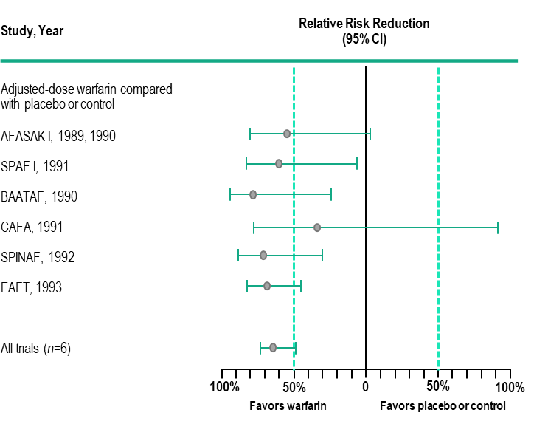
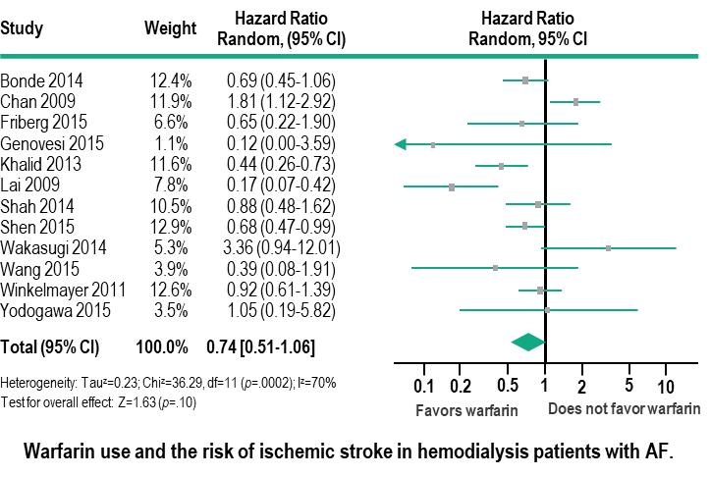
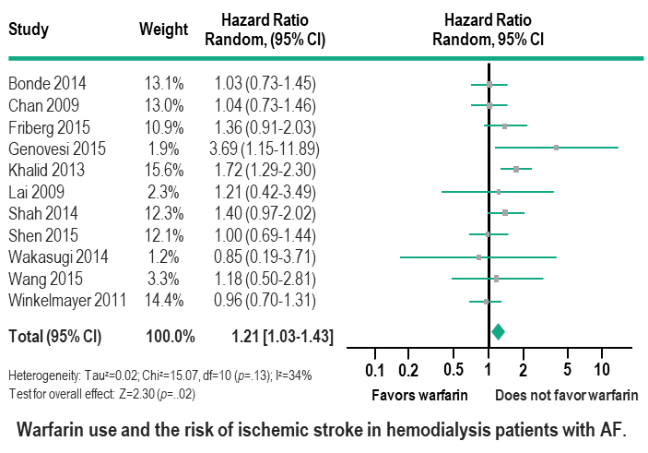
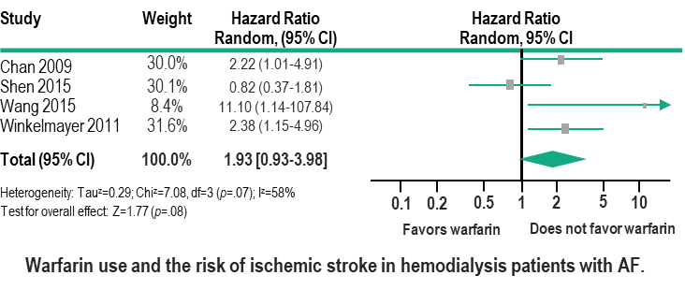
Warfarin Use in ESRD*
Cryptogenic 30%
Cardiogenic Embolism 20%
26% ↓ ischemic stroke
93% ↑ intracranial hemorrhage
Compared to 64% ↓ ischemic stroke
in Non-ESRD patients
21% ↑ major bleeding
Am Heart J 2017; 184:37-46.
Notes:
Speaker Notes:
Speaker Notes:
Slide has transitions
1st - Compared to 64% ↓ ischemic stroke in Non-ESRD patients
2nd - 21% ↑ major bleeding
3rd - 93% ↑ intracranial hemorrhage

Slide 37

Key Messages
Appropriate anticoagulation treatment should be started in the vast majority of AF patients as per the CCS guidelines
DOACs offer several advantages over warfarin, and should generally be used in preference to warfarin for SPAF for CrCl >15 mL/min
DOACs with low renal clearance such as apixaban or rivaroxaban can be considered for SPAF in patients with a CrClmL/min
In patients with CKD, eGFRs should be followed closely and other patient characteristics and co-morbidities (age, etc…) should be considered when selecting and dosing DOACs
Notes:
Speaker Notes:

Slide 38
Backup Slides

Slide 39
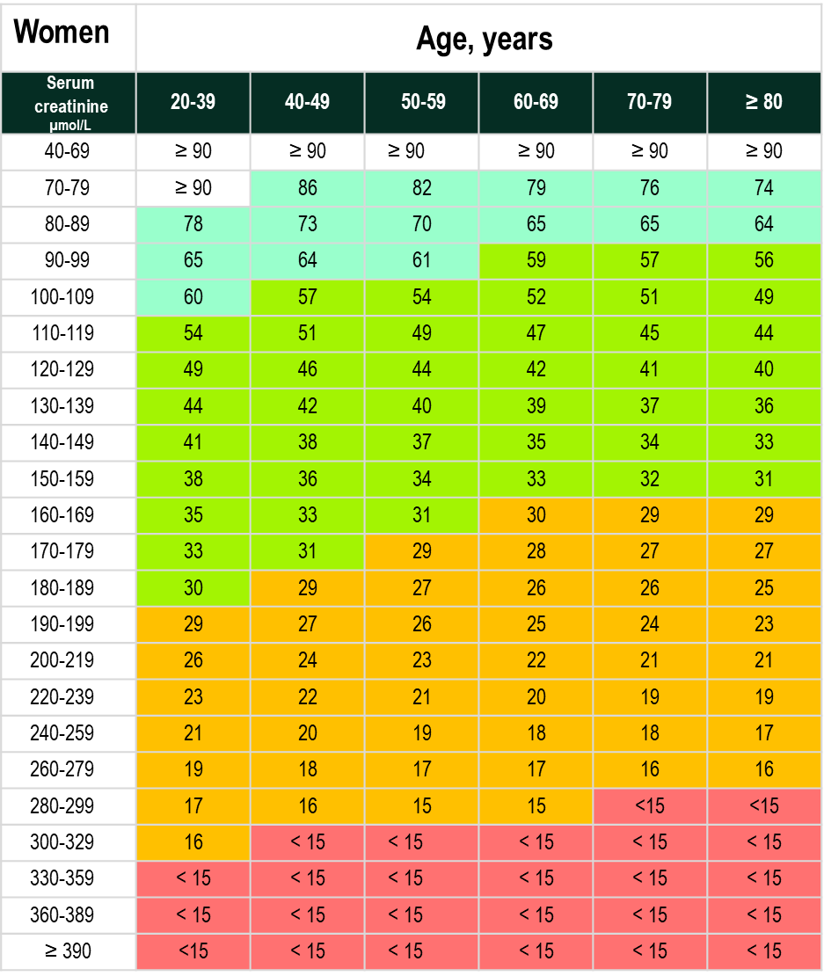
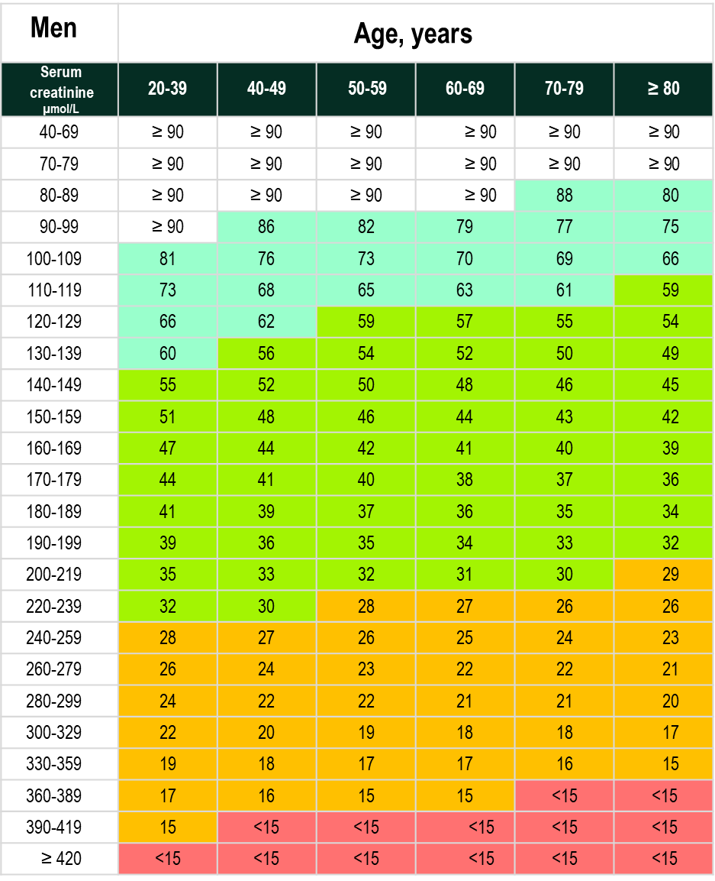
Serum Creatinine : eGFR Conversion Tables for Women and Men
Stage 1: eGFR > 90 ml/min with abnormalities on urinalysis or ultrasound
Stage 2: eGFR 60 – 89 ml/min with abnormalities on urinalysis or ultrasound
Stage 3: eGFR 30 – 59 ml/min
Stage 4: eGFR 15 – 30 ml/min
Stage 5: eGFR <15 ml/min
BC Medical Services Commission, Guidelines and Protocols Group
Notes:
Speaker Notes:
For those physicians whose laboratories are not yet able to calculate eGFR, the above tables provide approximate eGFR values.
Values have been calculated using the MDRD calculation (Levey et al. Ann Intern Med 1999;130:461-70.) and should be
considered approximate only. The use of the equation or table does not require a 24 hour urine sample collection. eGFR can then
be used to classify the patient to a CKD stage.

